Slide 1
UBER CASE STUDY (SUPPLY- DEMAND GAP) SUBMISSION
Name:
Mohammed Suhail Y

Slide 2
Business Objectives
To address the problem Uber is facing - driver cancellation and non-availability of cars leading to loss of potential revenue.
The aim of analysis is to identify the root cause of the problem (i.e. cancellation and non-availability of cars).
To recommend ways to improve the situation based on the analysis of the available Uber dataset.

Slide 3
Problem solving methodology
Split the day into timeslots based on the Request timestamp and identify the peak hours of every day.
Based on where the Pickup point is (Airport or City), Find the hourly status of the supply and demand problem of the cabs and find the location where the problem is severe i.e. Airport or City.
For the customers who did not complete their trip, identify the timeslots where this occurs most often, and determine the Supply-Demand gap at each pickup location separately to determine a solution.

Slide 4
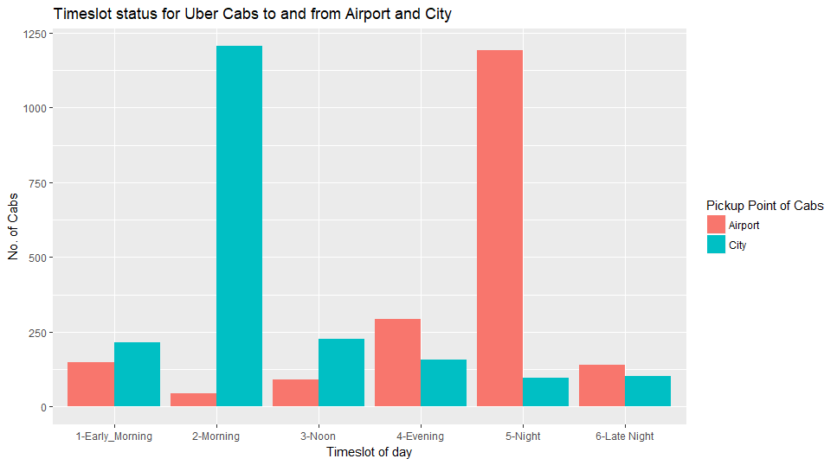
Analysis
Demand of cabs at the Airport and City throughout the day.
We can see that the demand is high at the City in the Morning and at Airport in the Night

Slide 5
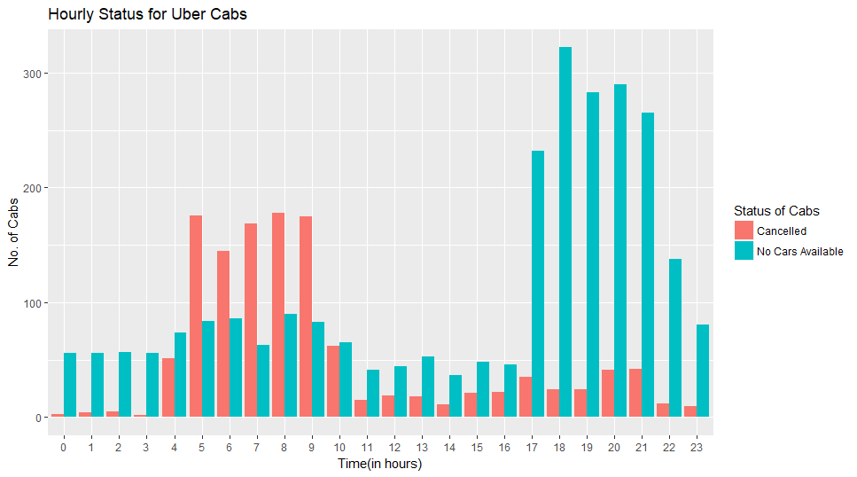
Analysis
The availability of cabs at city and airport throughout the day.
The number of cancellations is high in the Morning and no cars are available at Night.
Both these time durations are the peak timings and cabs aren’t available.

Slide 6
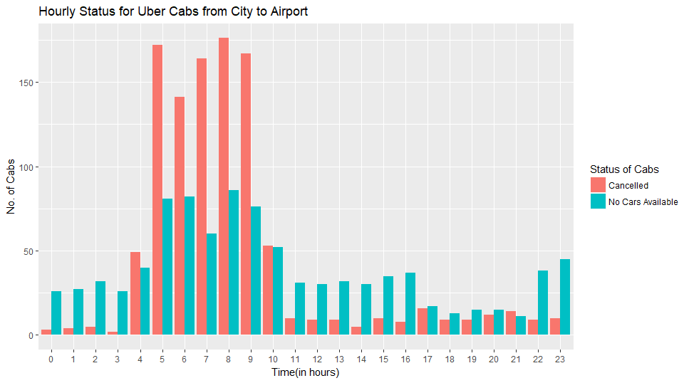
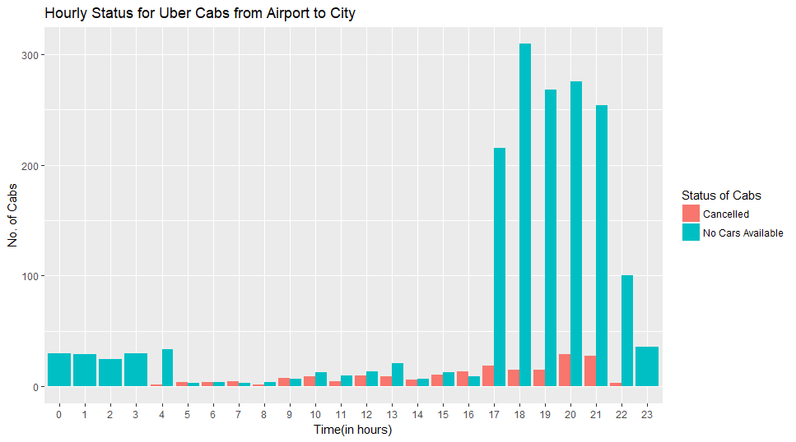
Analysis
As the cabs aren’t available during both peak times, let’s drill down and
determine which location cabs aren’t available the most
We can see that the cancellations is high in the morning, only at the city, where demand is high in the Morning.
We can also see that no cars available is high at night, only at the Airport, where demand is high at Night.
Hence morning, city has abundant cars and cancellations are made more, as a result not many cars
are available at night time to pickup the passengers as many drivers had decided not to go to Airport in the morning.

Slide 7
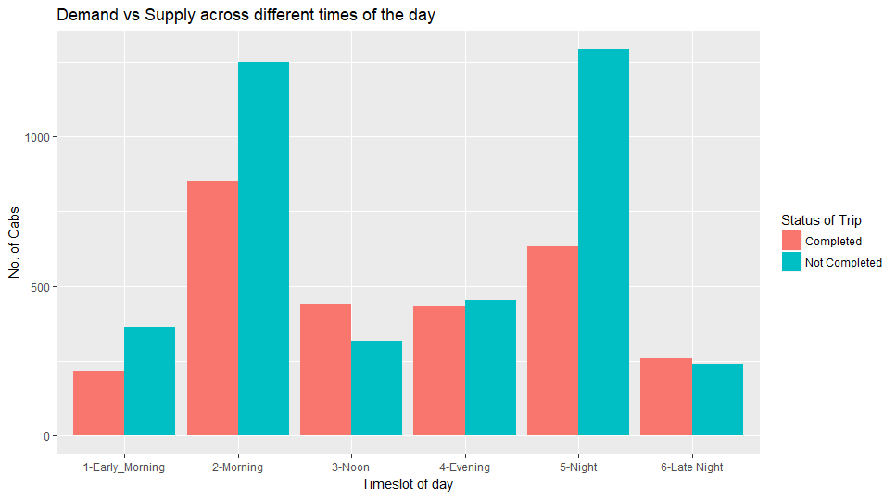
Analysis
Demand vs Supply of Cabs at city and airport throughout the day.
As stated earlier, the number of customers who don’t get a cab is high at Morning and Night times.

Slide 8
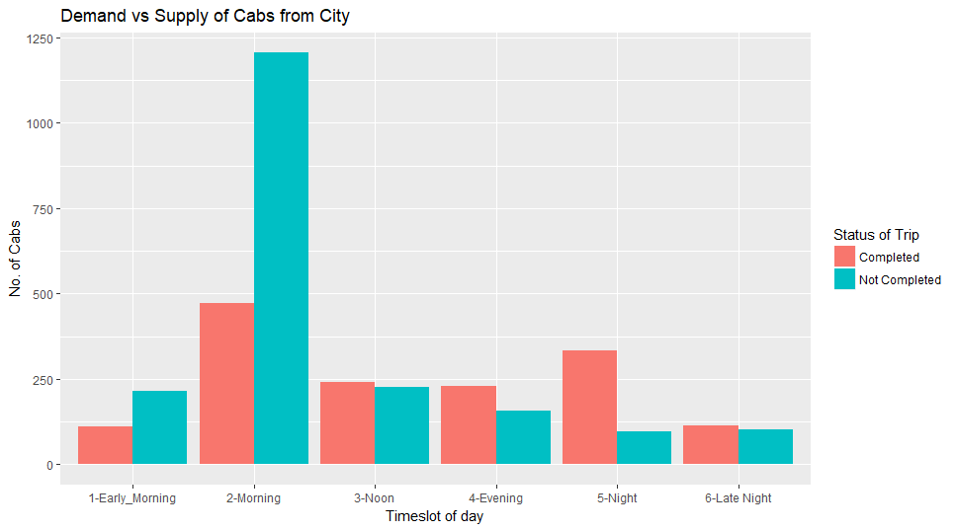
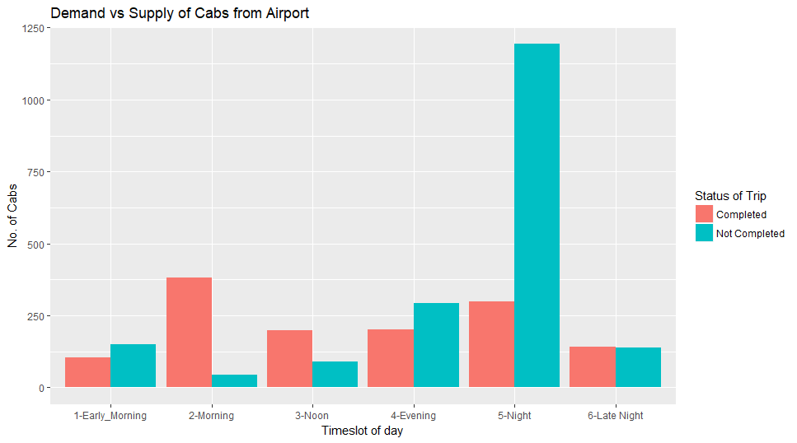
Analysis
We can see that as the cancellations is high in the morning at the city,
most of the customers do not get a cab booked and hence trip isn’t completed.
The same happens for the cars at the airport at night, since most of the drivers chose not to go
to the Airport in the morning, there are no cabs for people booking from the Airport at night as there are no cabs available.

Slide 9
Results
It is observed that the Cancellations are high in the Morning (5am-10am) at the city.
The non availability of cabs at the airport at Night time (6pm-10pm) is very high.
The supply demand gap is very high during these peak times and the number of people not completing their trip is much higher than the number of people who do.
The non availability of cars in the night time at airport could be linked to the high cancellations at the city in the morning.
It could be because drivers are reluctant to go to the airport and hence during night peak time, there are no drivers available.

Slide 10
Possible Resolutions
Drivers are reluctant to go to the airport during morning time, hence they could be given incentives and that would decrease the high number of cancellations.
To discourage cancellations, penalty could also be imposed.
The drivers who travel to airport could be made to stay there till evening time by providing local trips, so that they will be available at night peak time at the Airport.
Carpooling can also be encouraged to customers who travel to the Airport.

